Slide 1
RFP 26-008: ENGINEERING AND DESIGN SERVICES FOR THE Bradley Road – Hancock to Grinnell IMPROVEMENTS PROJECT
Pre-Proposal Meeting January 7, 2026 2:00 PM
El Paso County Department of Public Works
3275 Akers Drive
Colorado Springs, CO 80922
719-520-6460

Slide 2
Project Team
Procurement:
Matthew Marter, Senior Procurement Specialist
MatthewMarter@elpasoco.com
719-520-6663
Engineering:
John Andrews
Brett Hartzell, P.E.

Slide 3


Funding Source
State/CDOT – Fuel Impacts Enterprise
El Paso County
El Paso County Oversight
State/CDOT Reporting
No Davis-Bacon Requirements

Slide 4
Timeline
Activity | Deadline
Pre-Proposal Conference | 2:00 PM, Wednesday, January 7, 2026
Final RFP Questions Due | 10:00 AM, Monday, January 12, 2026
Proposal Due Date | 11:00 AM, Wednesday, January 28, 2026
Proposal Review / Consultant Interviews | January 28th through February 11th, 2026
Issue Notice of Intent to Award | February, 2026
Anticipated Start Date | March, 2026

Slide 5
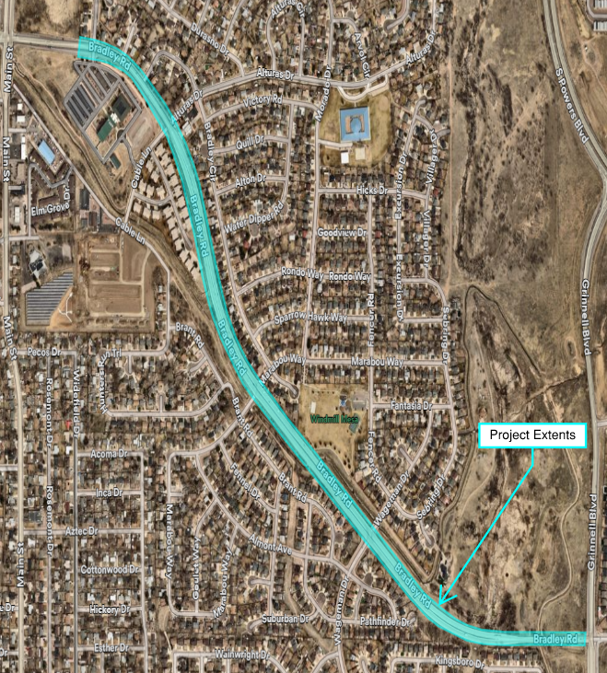
Project Location
Bradley Road
- 1.4 mile segment between Hancock Expressway / Main Street and Grinnell Boulevard
- Urban Principal Arterial
- 6 Intersections within segment
- Cantrell Drive, Bradley Lane, Bradley Circle,
Alturas Drive, Marabou Way, Wageman Drive
- El Paso County Right-of-Way

Slide 6
Project details
Bradley Road Background:
1.4 mile stretch of Urban Principal Arterial
Primarily 4 lanes, reduces to 2 for southernmost 1000’
120’ ROW standard, reduces to 50’ for southernmost section
6 Total Intersections, all stop controlled
2 3-Way Intersections: Bradley Circle & Bradley Lane
4 4-Way Intersections, Wageman & Cantrell lack RT lanes
Pedestrian/Multimodal infrastructure lacks crossing capabilities throughout the corridor
Ancillary route for fuel and truck traffic

Slide 7
PROJECT SCOPE
Drainage Study and Analysis – Hydrology, MS4 Criteria, Permitting
FEMA No Rise (2 Lane Segment Floodplain)
Geotechnical Study and Analysis – Field exploration and Subsurface Investigation (20 Borings anticipated)
Design Survey – Topographic, Survey Control, Utility locates
Traffic and Safety Analysis – Traffic/Turning Movement Counts, Intersection Control Evaluation (ICE), Conceptual Lighting
Property Acquisition – Permission to Enter (PTE), Property Impacts, Acquisitions
Preliminary and Final Engineering Design
30% Combined with Alternative Analysis (as applicable)
60% (FIR) Schedule, Phasing, Erosion Control (ESQCP), Estimates
Final Design (FOR to BID)

Slide 8
Project Timeline
Design: March 2026 – December 31, 2027
2026:
Survey, Investigations, Studies
Alternative Analysis
Preliminary Design
60% Design
2027:
Property Acquisition
Final Design, Permitting
Bid Set

Slide 9
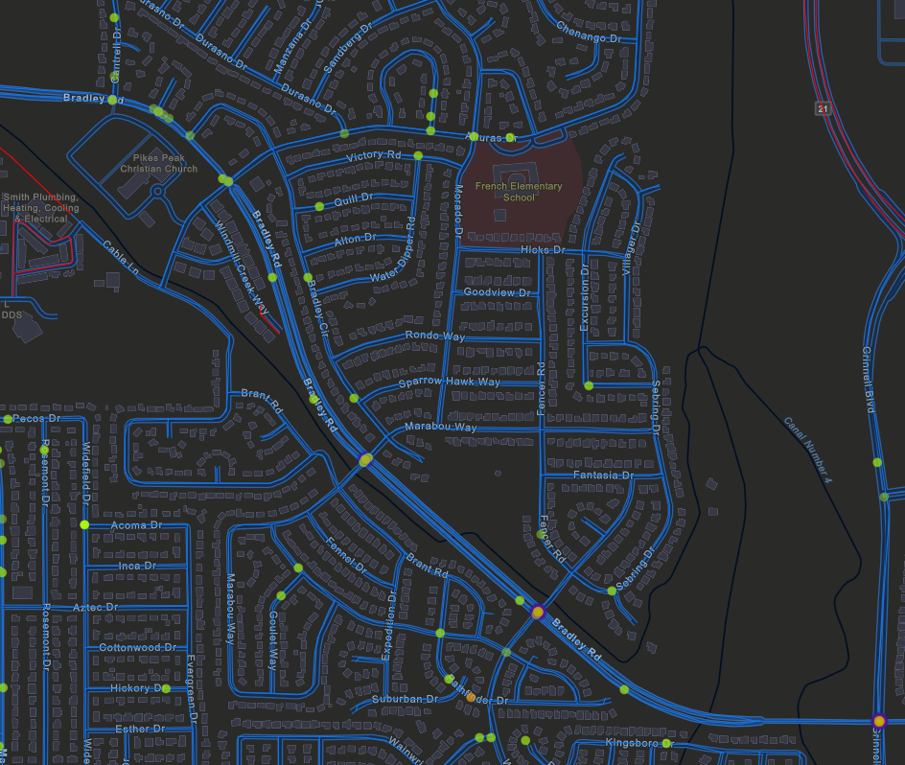
Traffic DETAILS
Crash Data:
50+ Incidents along corridor since 2018
0 fatalities
PPACG Crash Data available
Intersections primary collision points
Marabou and Wageman have highest occurrences

Slide 10
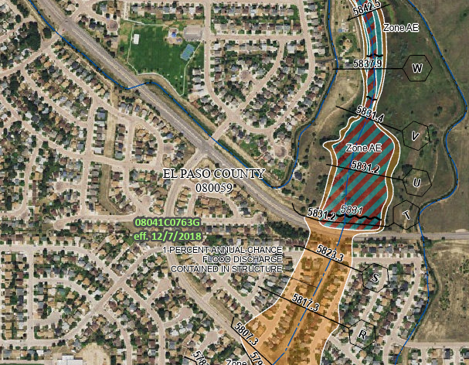
Drainage DETAILS
Roadway Drainage:
Primarily Roadside Ditch
6 Median inlets
Primarily outfalls to Fountain Mutual Irrigation Canal No. 4
Irrigation Canal box culverts present at Marabou and Wageman
FEMA Floodplain
AE bounds N extents of 2-lane segment, roadway generally contained within 1% Annual Chance

Slide 11
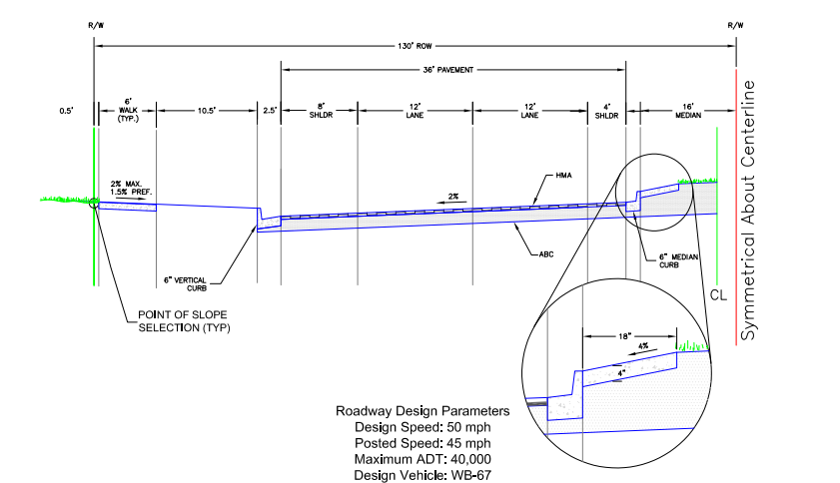
Project details II
Roadway
Mixture of existing conditions throughout corridor:
Cantrell to Alturas: C&G w/ reduced shoulder, striped median
Alturas through Wageman: Expanded shoulder, C&G median – variable width
Grinnell Connection: Reduced shoulder, no median
Posted speed of 40 MPH, intermittent guardrail south of Marabou (abutment with Irrigation Canal)
Pedestrian features limited to intersections

Slide 12
Property ACQUISITION/ACCESS
Permission to Enter Property (PTE) will be required prior to investigative work & survey on all private property
Access to all residential and commercial properties to be maintained, some additional coordination required:
Security Fire Department Station 3
Widefield School District No. 3
Appraisals not anticipated, consultant shall perform negotiations with all affected property owners.
14 Legal Descriptions & 6 Legal Exhibits anticipated

Slide 13
Utilities
Expected Conflicts:
Fountain Mutual Irrigation Company (Canal No. 4)
El Paso County (Windmill Gulch EDB)
Contactor to coordinate will all other utility companies as necessary
Potholing will be required, assumption of 40 potholes
811 coordination required
SUE Quality Level A expected for Final Design

Slide 14
General Notes
Design shall be primarily focused on safety improvements and reconstruction of roadway to meet County criteria
Intersection Improvements
Corridor Lighting
Road Widening/Continuity
Phasing and Traffic Control plans will be included in final design, but shall be informational in nature.
Due to nature of FIE funding, Consultant shall pursue a shovel-ready design with potential for design services during construction.

Slide 15

questions

